Slide 1


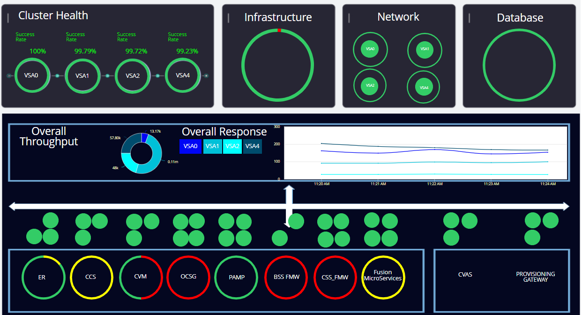
ENG FUSION
Good/Healthy/Normal
Warning/Caution
Critical/Error/Failure
Health status and success percentage for individual clusters
Infrastructure
Status Indicators for Physical Infrastructure, Network, and Database Health
Overall throughput for VSA 0, 1, 2, and 4: Calls per minute and their average response times
Status of physical infrastructure, database performance, network metrics, packet loss, and data throughput
VSA0, VSA1,VSA2 AND 4 AVERAGE RESPONSE TIME
Performance for all internal systems, with emphasis on average response time
Downstream internal systems including external, with application health status

